Slide 1
Designing Microservices
Lecturer: Ngo Huy Bien
Software Engineering Department
Faculty of Information Technology
VNUHCM - University of Science
Ho Chi Minh City, Vietnam
nhbien@fit.hcmus.edu.vn

Slide 2

Objectives
To decompose a system into microservices.
To implement a microservice.

Slide 3

Contents
Microservices decomposition
Microservices implementation

Slide 4

References
https://martinfowler.com/articles/microservices.html
Sam Newman (2021). Building Microservices - Designing Fine-Grained Systems. O'Reilly Media.

Slide 5
Microservice Boundary [1]
Microservices are just another form of modular decomposition.
What makes for a good microservice boundary—information hiding, cohesion, and coupling.
Information hiding describes a desire to hide as many details as possible behind a module (or, in our case, microservice) boundary.
The connections between modules are the assumptions which the modules make about each other.
By keeping the number of assumptions small, it is easier to ensure that we can change one module without impacting others.
A structure is stable if cohesion is strong and coupling is low.

Slide 6
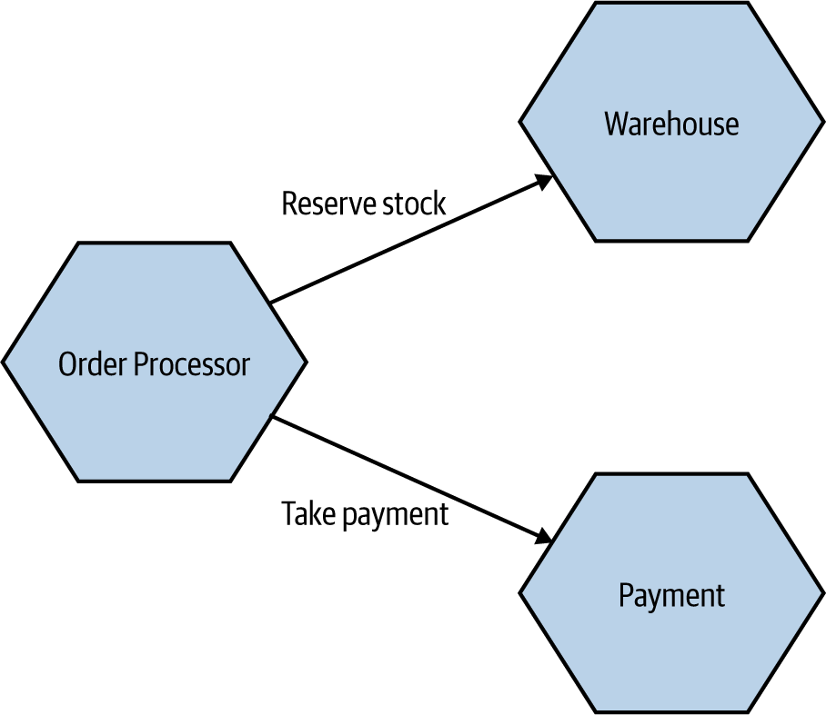
Domain Coupling
Domain coupling describes a situation in which one microservice needs to interact with another microservice, because the first microservice needs to make use of the functionality that the other microservice provides.

Slide 7
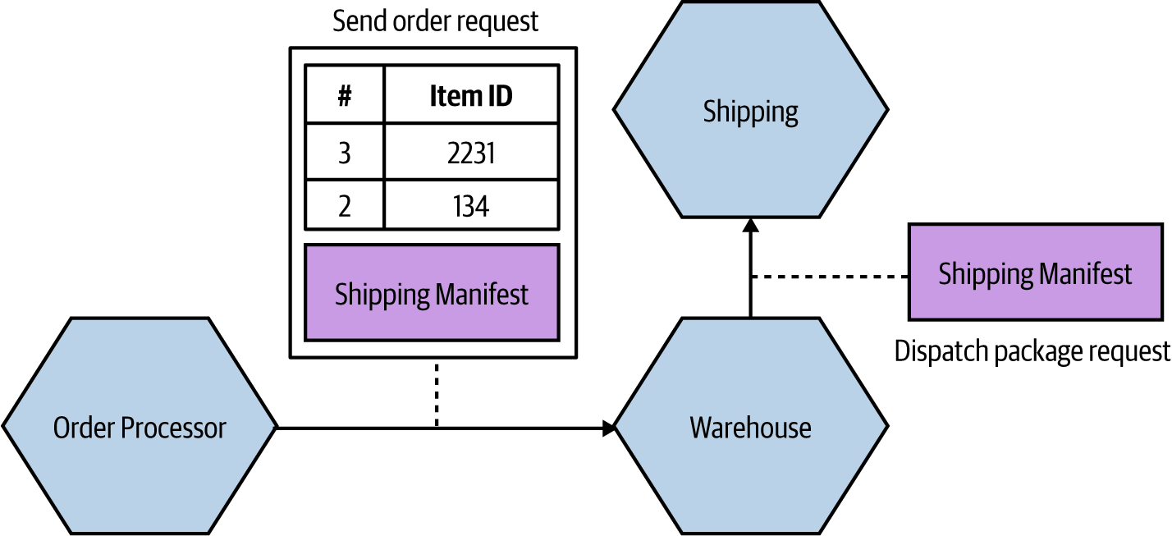
Pass-Through Coupling
Pass-through coupling describes a situation in which one microservice passes data to another microservice purely because the data is needed by some other microservice further downstream.
We have an Order Processor, which is sending a request to Warehouse to prepare an order for dispatch.
As part of the request payload, we send along a Shipping Manifest.
This Shipping Manifest contains not only the address of the customer but also the shipping type.
The Ware house just passes this manifest on to the downstream Shipping microservice.

Slide 8
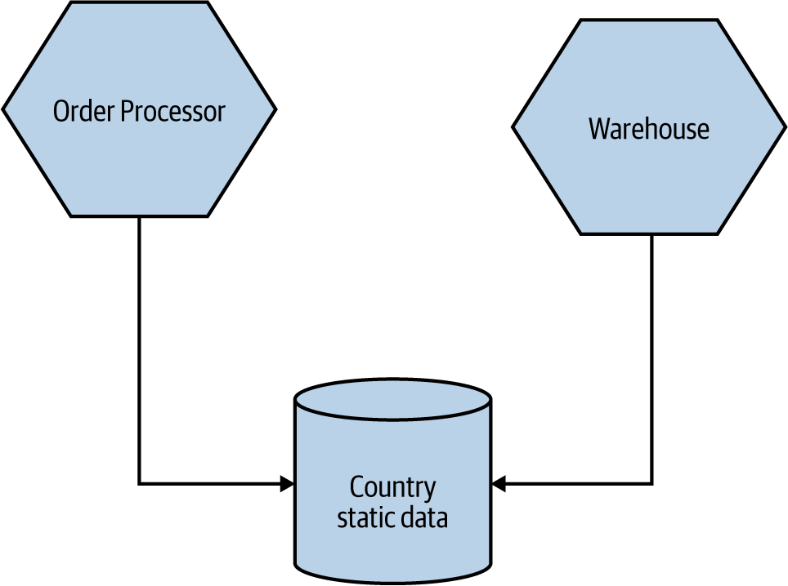
Common Coupling
Common coupling occurs when two or more microservices make use of a common set of data.
A simple and common example of this form of coupling would be multiple microservices making use of the same shared database, but it could also manifest itself in the use of shared memory or a shared filesystem.

Slide 9
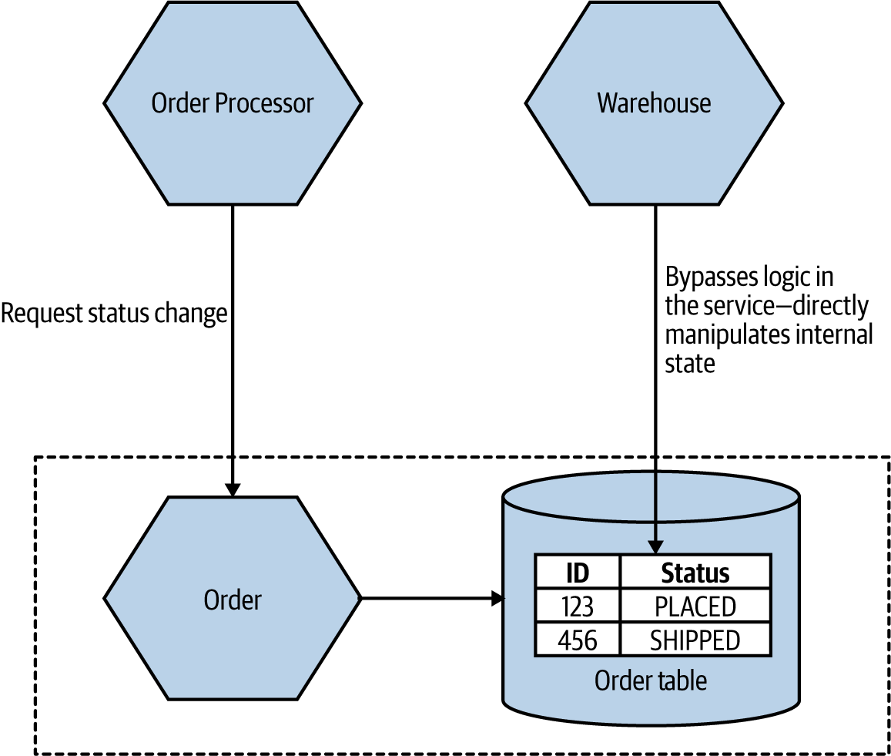
Content Coupling
Content coupling describes a situation in which an upstream service reaches into the internals of a downstream service and changes its internal state.
The Warehouse is directly accessing the internal data of the Order service.

Slide 10


Slide 11

Domain-Oriented Decomposition

Slide 12
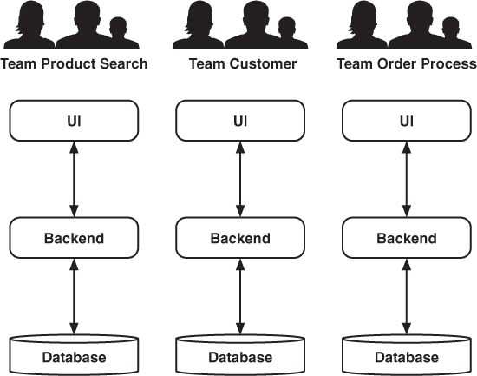
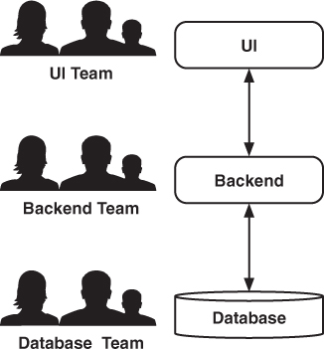
Organizational Decomposition
Any organization that designs a system (defined broadly) will produce a design whose structure is a copy of the organization's communication structure.
-- Melvyn Conway, 1967

Slide 13
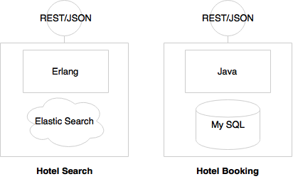
Technology Decomposition [2]
Hotel Search is expected to have high transaction volumes with stringent performance requirements, it is implemented using Erlang. In order to support predictive searching, ElasticSearch is used as the data store.
Hotel Booking needs more ACID transactional characteristics. Therefore, it is implemented using MySQL and Java. The internal implementations are hidden behind service endpoints defined as REST/JSON over HTTP.

Slide 14
Selecting Frameworks
Spring. https://spring.io/projects/spring-boot (Java)
Axon Framework. https://developer.axoniq.io/axon-framework/ (Java)
Micronaut. https://micronaut.io/ (Java, Kotlin, and Groovy)
.NET Core https://docs.microsoft.com/en-us/aspnet/core/ (C#)
Nest (NestJS). https://nestjs.com/ (JavaScript)
Moleculer. https://moleculer.services/ (JavaScript)
Fastify. https://www.fastify.io/ (JavaScript)
Go Micro. https://github.com/asim/go-micro (Go)
Lumen. https://lumen.laravel.com/ (PHP)
Vert.x. https://vertx.io/ (Multiple languages)

Slide 15

Microservice Implementation
Service entry point implementation
RESTful APIs. Why?
GraphQL APIs. Why?
gRPC APIs. Why?
Logic and persistence implementation
Authentication
Access Control
Background Services
Domain-driven design (Service entry point separation, storage selection: Relational databases. Why?, noSQL databases. Why?)
Distributed transaction processing

Slide 17
MonolithFirst
https://martinfowler.com/bliki/MicroservicePremium.html
The majority of software systems should be built as a single monolithic application.
Do pay attention to good modularity within that monolith, but don't try to separate it into separate services.
https://martinfowler.com/bliki/MonolithFirst.html
By building a monolith first, you can figure out what the right boundaries are, before a microservices design brushes a layer of treacle over them.

Slide 18
Don't Start With a Monolith
… when your goal is a microservices architecture
https://martinfowler.com/articles/dont-start-monolith.html
But if you start with a monolith, the parts will become extremely tightly coupled to each other. That's the very definition of a monolith. The parts will rely on features of the platform they all use. They'll communicate based on abstractions that are shared because they all use the same libraries. They'll communicate using means that are only available when they are hosted in the same process. And these are only the technical aspects! Far worse than that, the parts will (almost) freely share domain objects, rely on the same, shared persistence model, assume database transactions are readily available so that there's no need for compensation … Even the very fact that it's easy to refactor things and move them around – all in the convenience of your IDE's view of a single project – is what makes it extremely hard to cut things apart again. It's extremely hard to split up an existing monolith into separate pieces.

Slide 19

My Opinion
Start with a monolithic application.
Do pay attention to modularity within the monolith.
Aim to break it into microservices as soon as possible.

Slide 20

Thank You & See You Again

